Slide 1
School management
Alexander Jamieson
Brandon Lauer
Jing Wang(Team leader)
Suim Park
Thanh Tung Pham

Slide 2
Purpose of the system
- Help to manage users and books
- Allows teacher to add, modify, and delete users(students) and books
- Allows every user to see the list of books
- Can search books with title or author

Slide 3
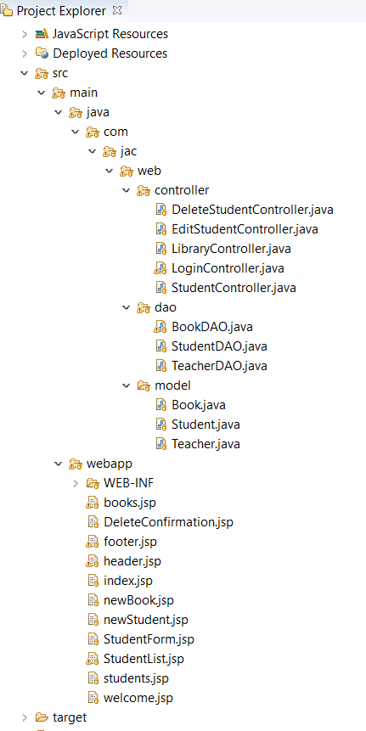
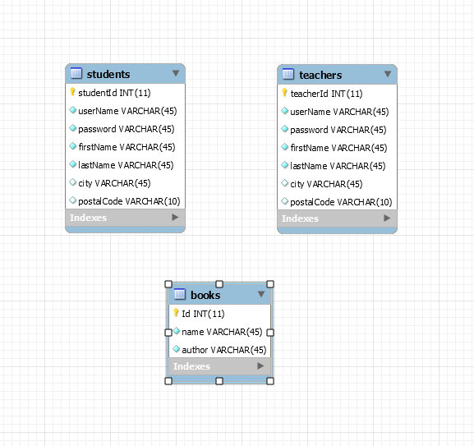
technologys
- MVC with Servlets and JSP
- MySQL JDBC
- Database on cloud – gear host

Slide 4
Challenges and Learn
- Learn how to fix configuration in various problem situations
- Use same page for the for creating and updating (Student and Book)
- Use one controller for Library - create, edit, delete, update, search actions

Slide 5
Future work
- Use Spring MVC
- Use Hibernate

